Slide 1
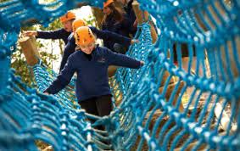
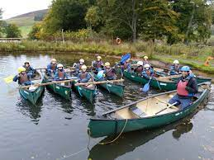
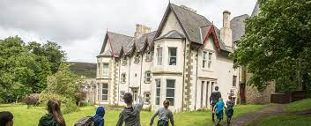
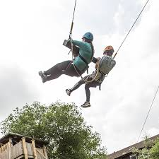
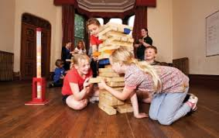
Robinwood 2025
Wednesday 19th – Friday 21st March 2025

Slide 2
Staffing
Mr Hindess
Mrs Dodds
Miss Bell
+
Pupils are arranged into activity groups (mixed between both classes). Groups of 10 – 12 children.
There will be one adult from school and one Robinwood leader with each group.
Notes:
Chn have been arranged in activity groups – 1 leader from Robinwood and 1 adult from school. Mixed between classes.

Slide 3
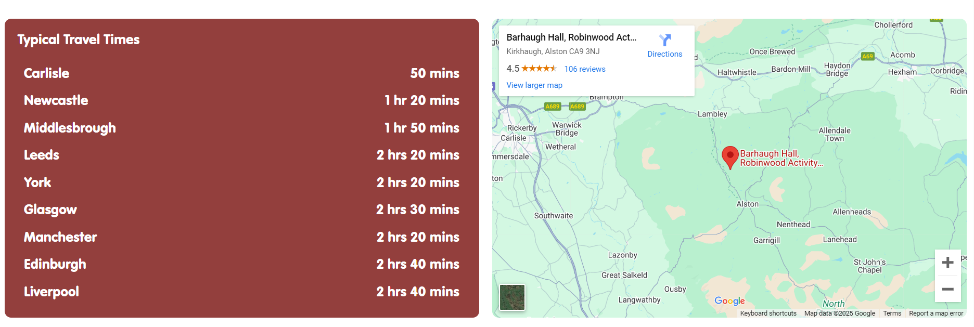
Where are we going? Barhaugh Hall, Alston, Cumbria

Slide 4
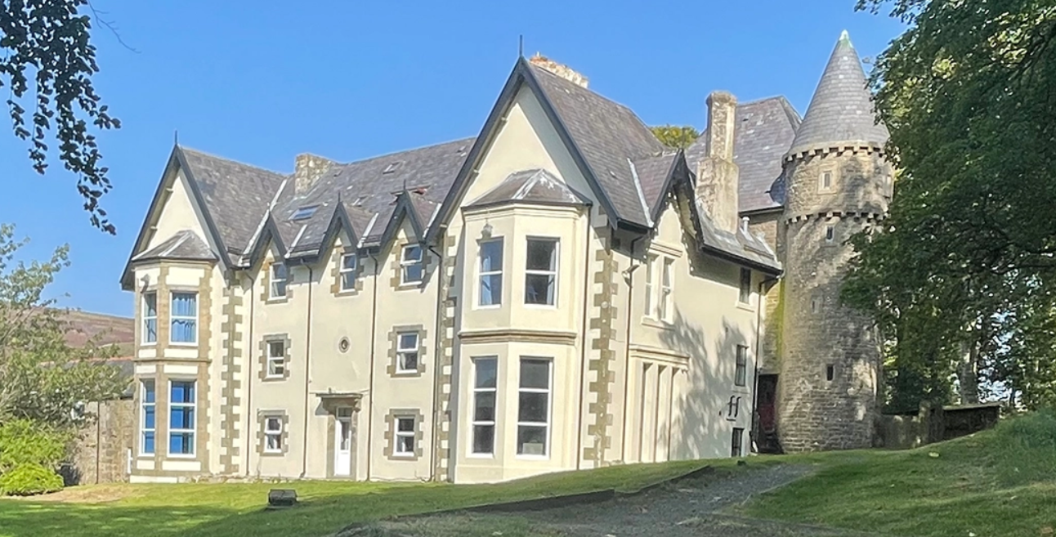
How will we get there? Walking to the accommodation
We walk for approximately 1 mile up to the accommodation, from the coach drop off point.
Luggage is taken by mini bus.

Slide 5
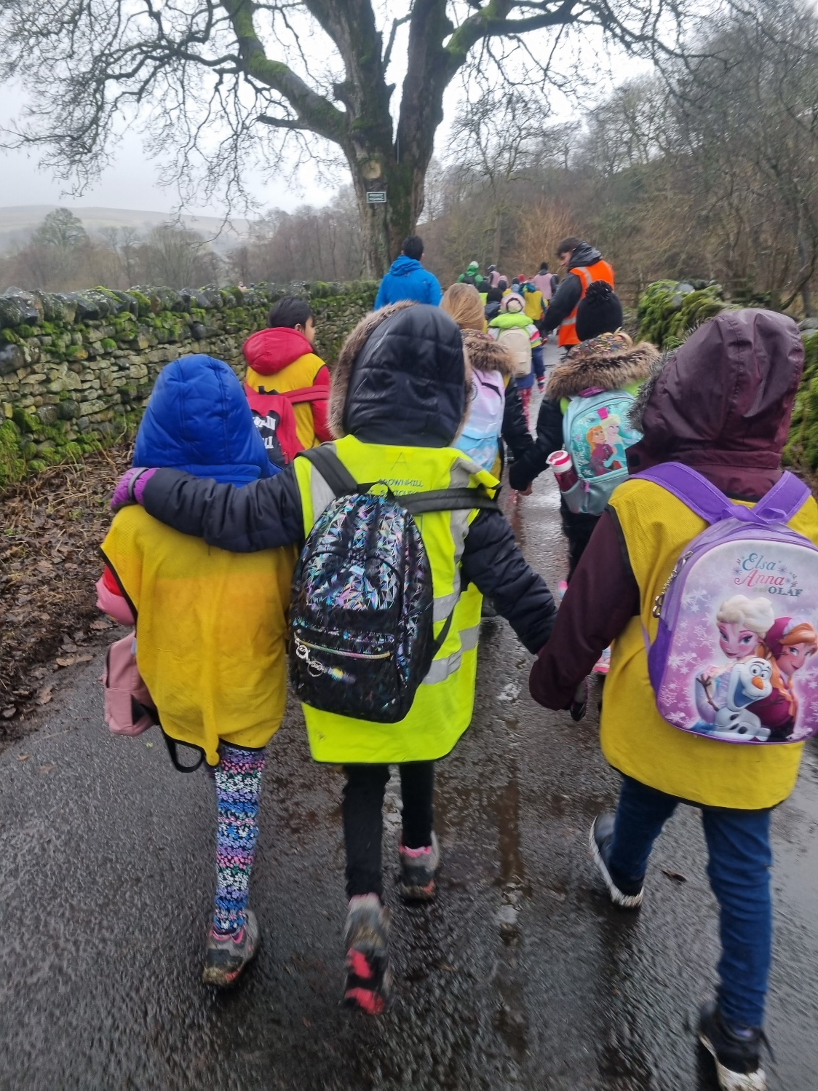
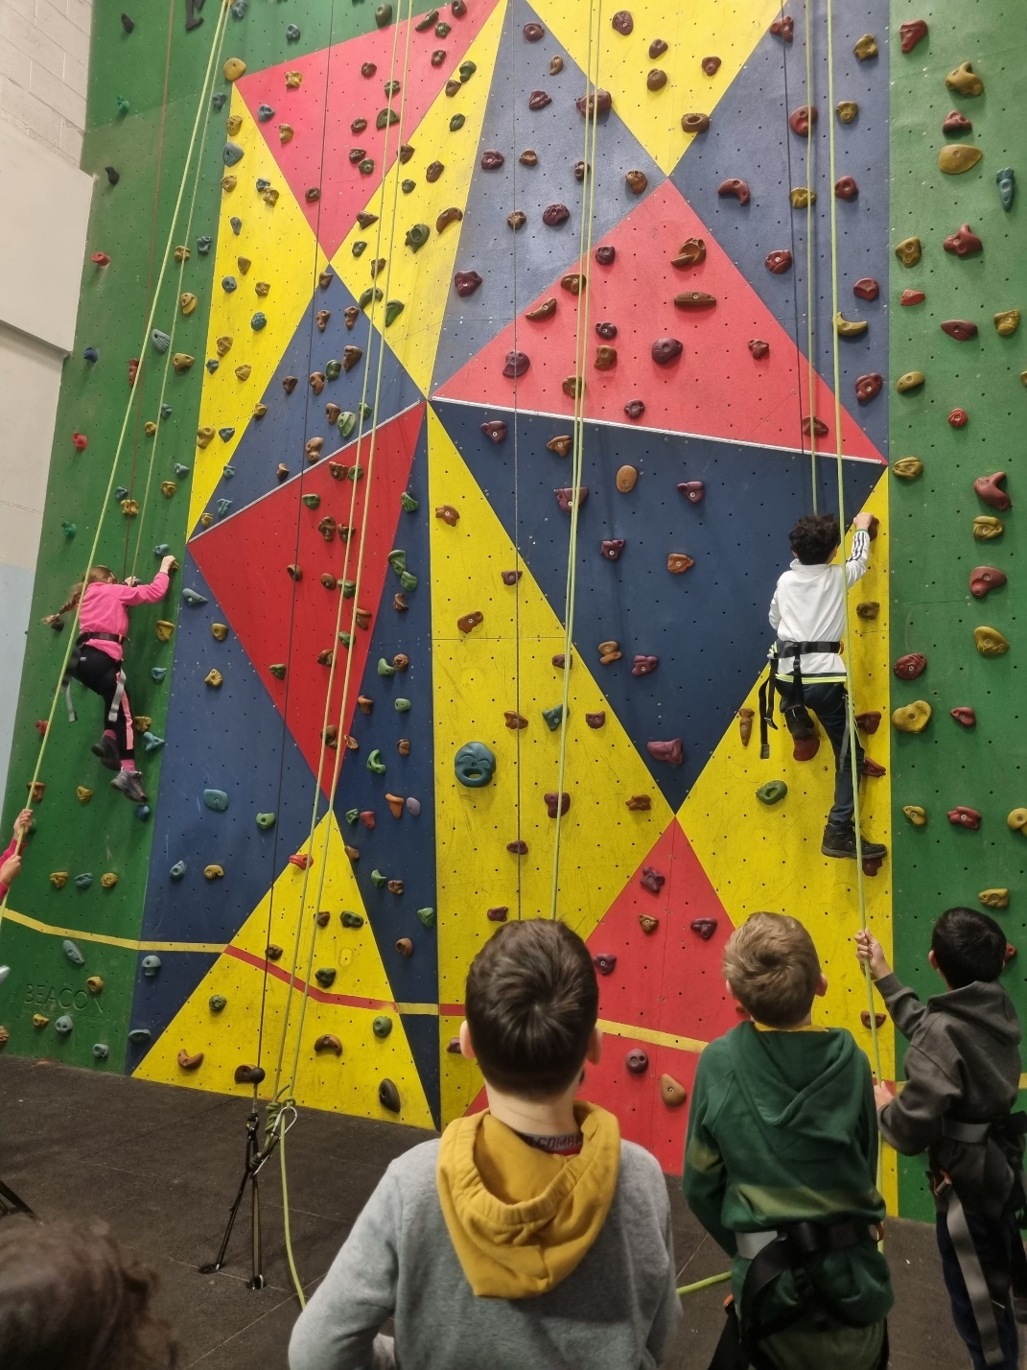
Wednesday 19th March
How will we spend our time there?
Leave school approximately 9:15
Arrive at coach park (10:30) – walk to accommodation (50 minutes)
Lunch (12:30)
Three afternoon activities (approximately one hour per activity)
Evening meal (17:00 – 18:00)
Evening activity
Team challenge (staff changeover)
Bed time (approximately 20:30 – 21:00)

Slide 6
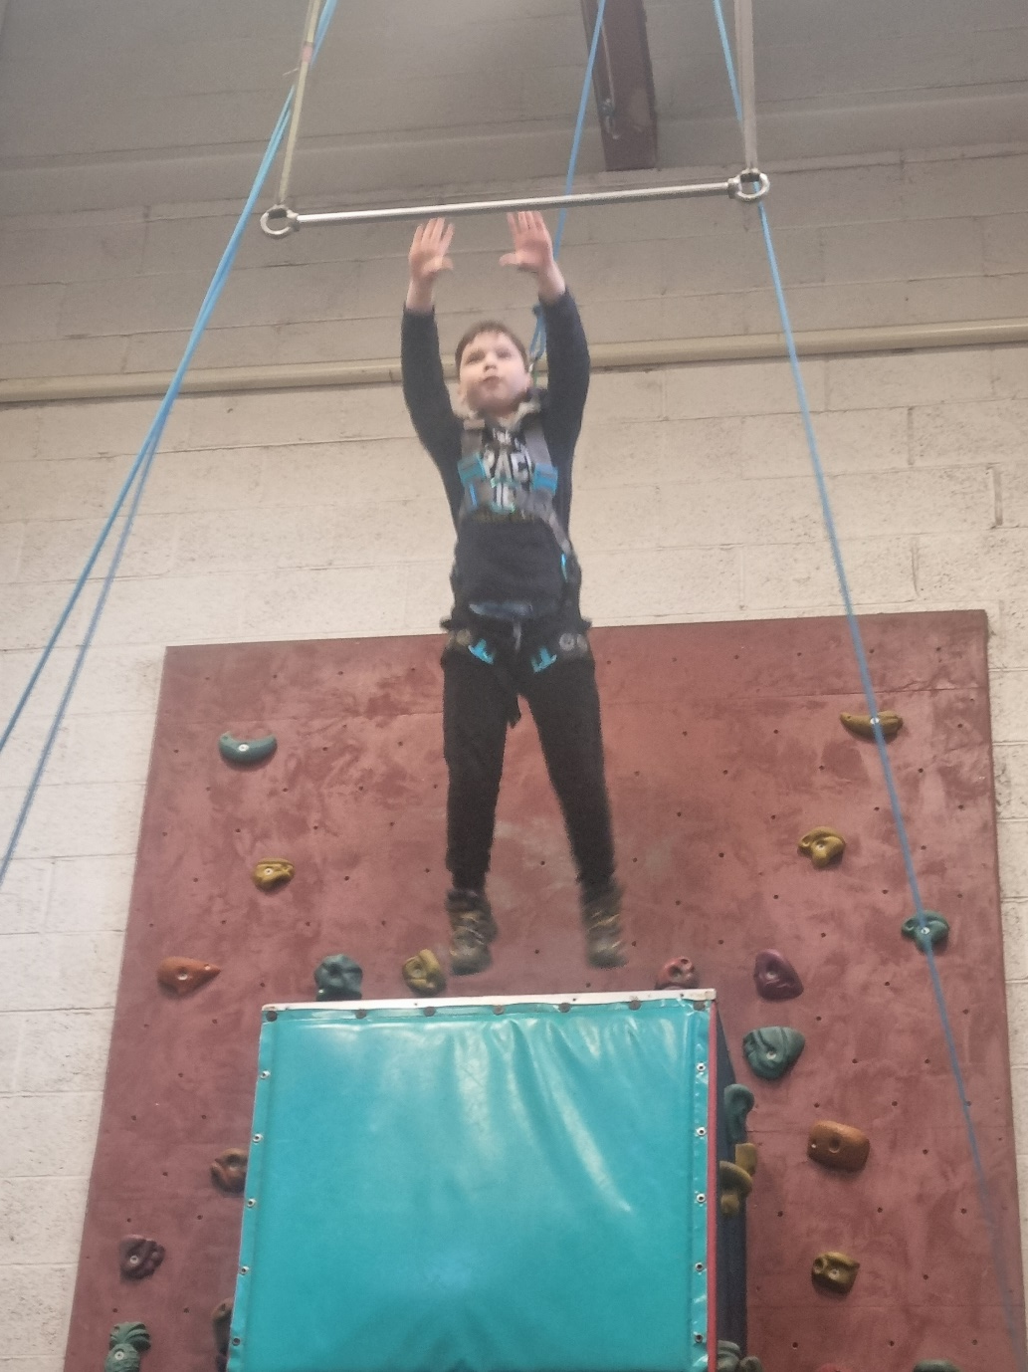
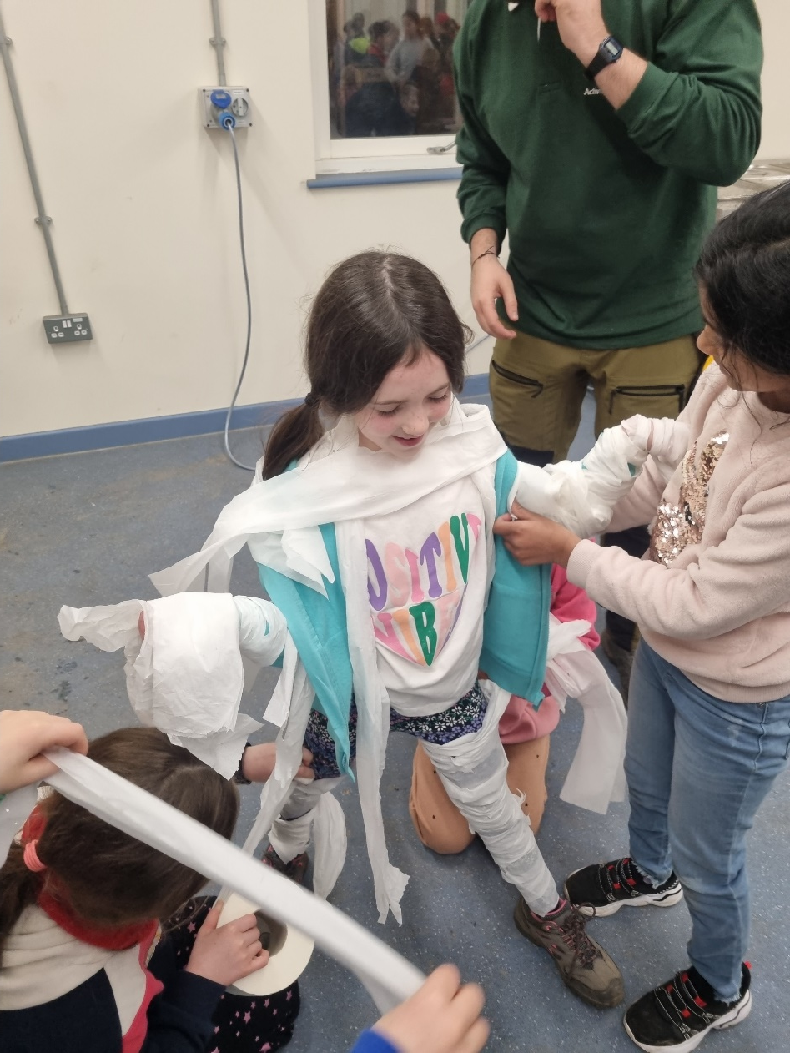
Day 2: Thursday 20th March
Breakfast (8:00)
Three morning activities
Lunch (13:00 – 14:00)
Three afternoon activities
Evening meal (18:00 – 19:00)
Team challenge
Bed time (approximately 20:30 – 21:00)

Slide 7
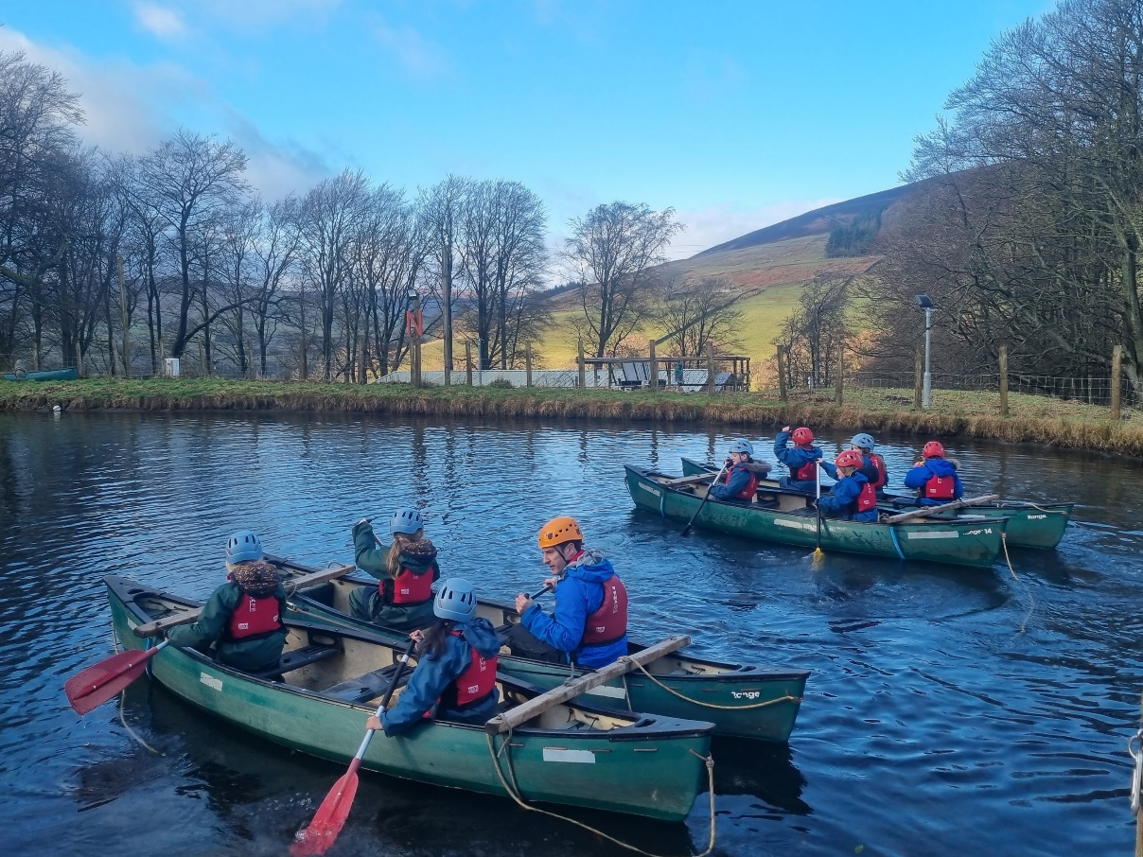
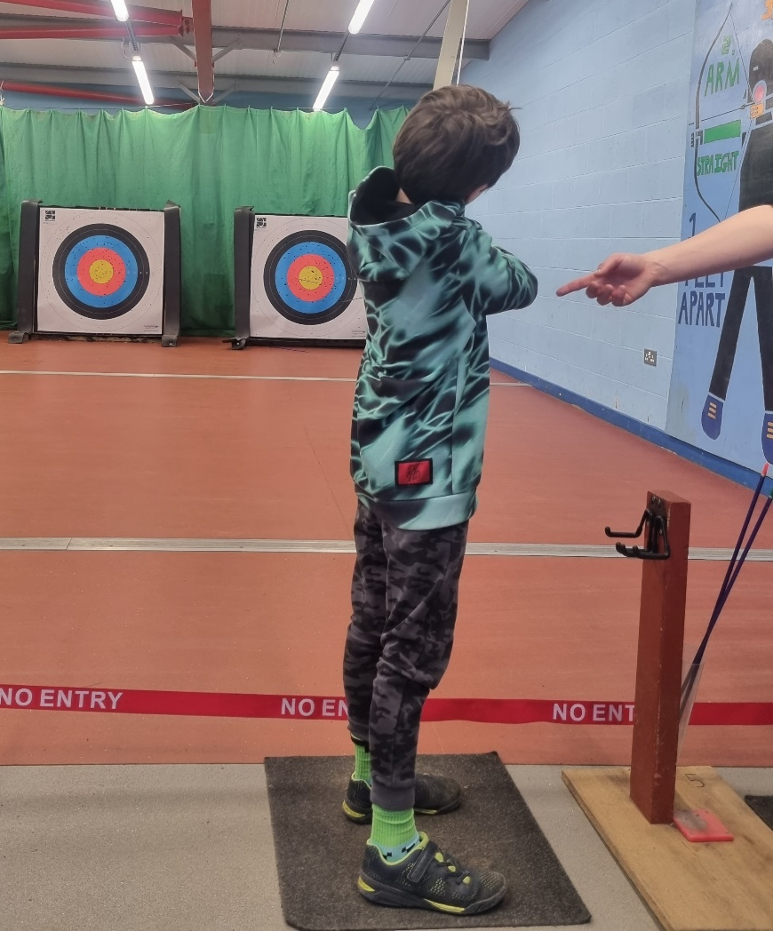
Day 3: Friday 21st March
Breakfast (7:20)
Two morning activities
Lunch (11:30 – 12:00)
Walk back to coach park
Travel back to school (approximately 13:20 departure)

Slide 8
What will the activities be?
Archery Canoeing Caving Crate Challenge Climbing
Obstacle Course Giant Swing Night line Piranha pool Knight’s Quest

Slide 9
When will we do the activities?
Each group has their own activity itinerary for each day.

Slide 10
Key skills:
Resilience
Responsibility
Encouragement
Developing skills
Problem solving
Communication
Confidence
Listening
Patience
Respect
Cooperation
Listening

Slide 11
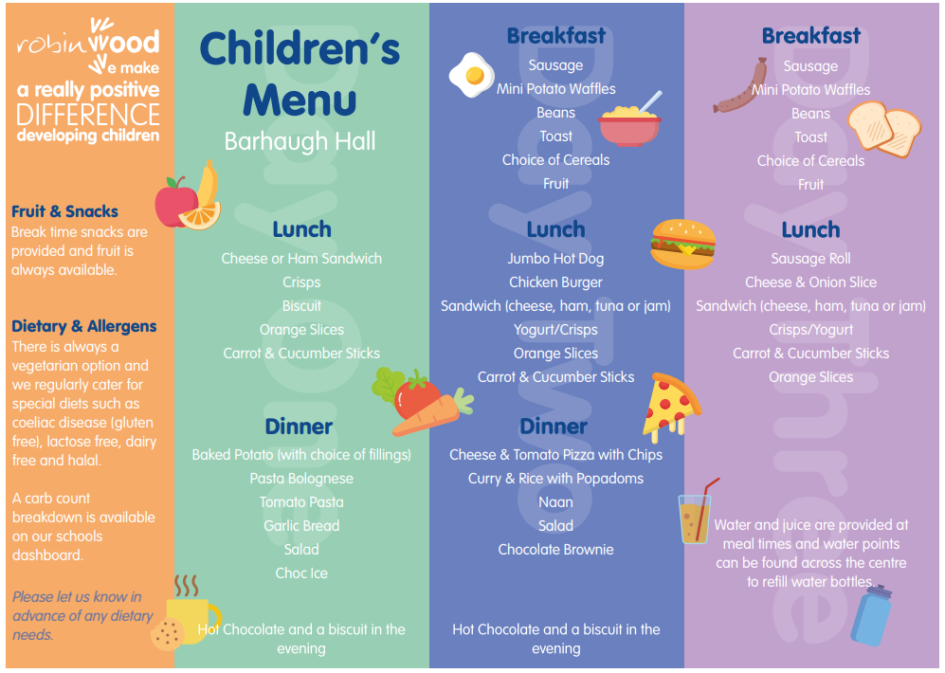
What will we eat?
Example menu options.
*Robinwood staff will be informed in advance of dietary needs.

Slide 12
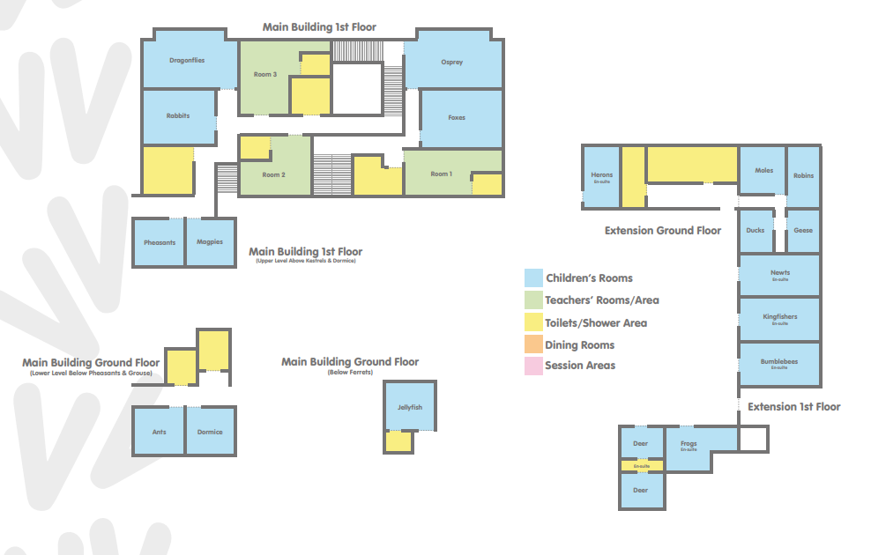
Where will we sleep?
Room layout.
6 boys’ rooms
4 girls’ rooms
Different sized dormitories.
Children grouped across year group.

Slide 13
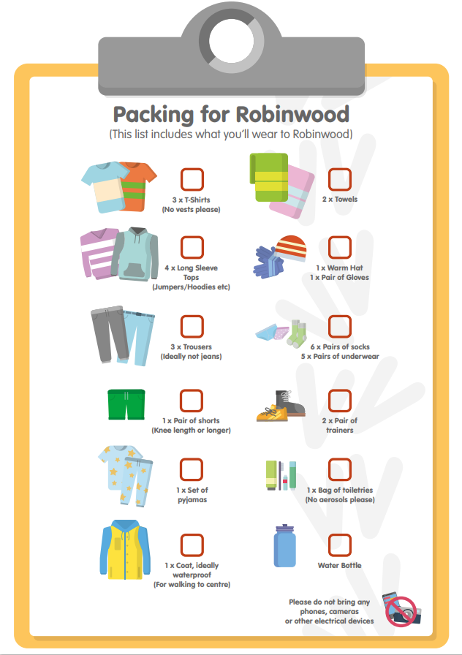
Packing
for
Robinwood

Slide 14
Enuresis

Slide 15
Before the trip:
Information/medication forms and E7 submitted to school
deadline Friday 7th February
Souvenir orders and cash by Friday 14th March
Check payments
Final group arrangements – will be shared with children.
Kit List – will be sent out again.
Communication during the trip will be regularly through X

Slide 16
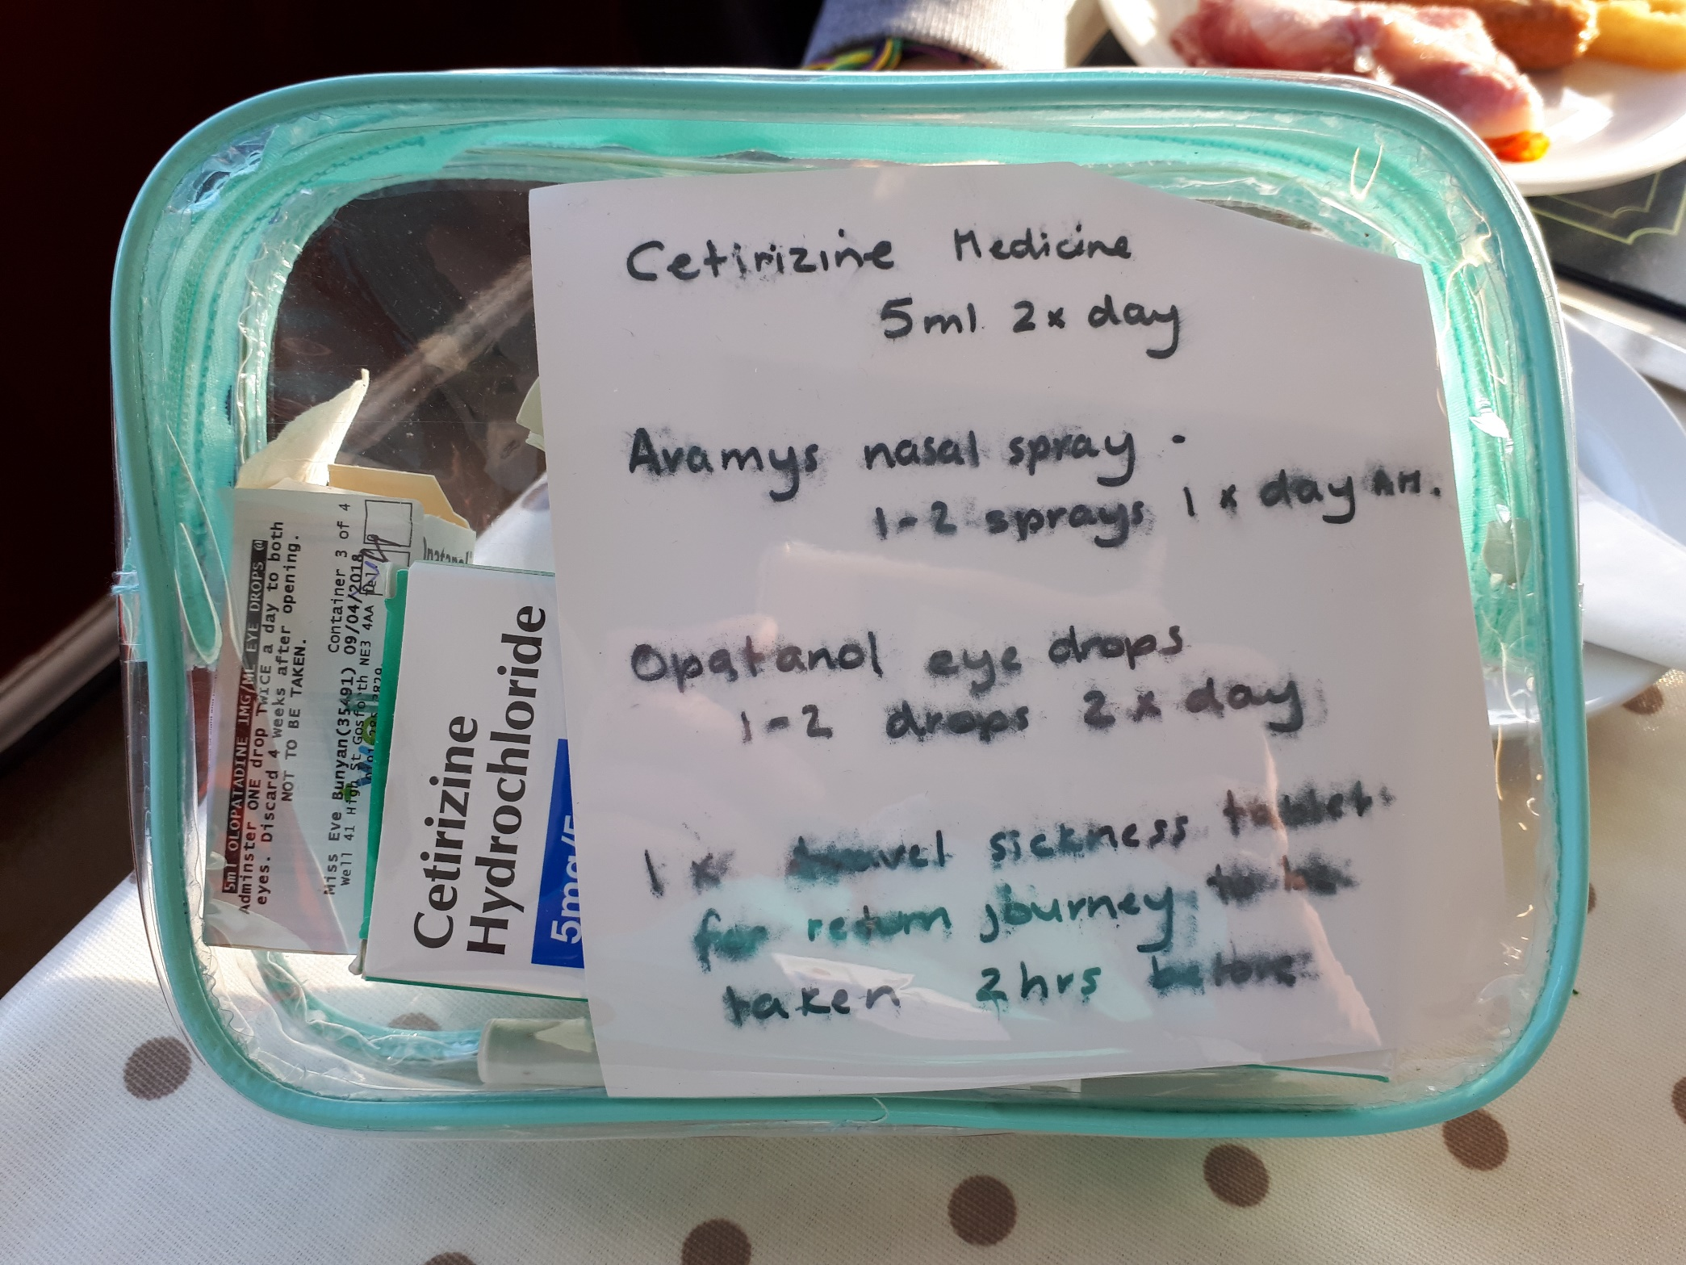
Medication

Slide 17
Any questions?

