Slide 1
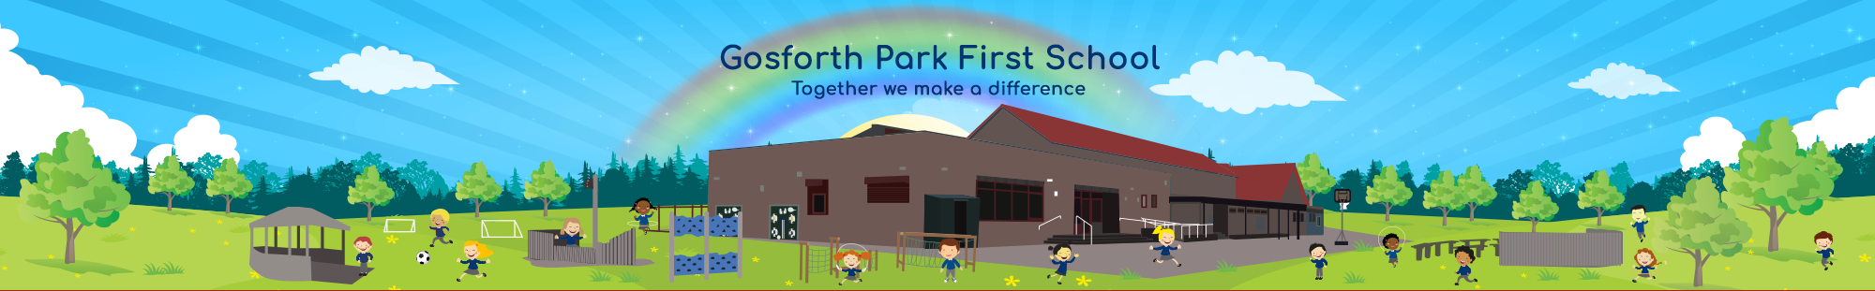

Relationships and Sex Education
Consultation
Confidence | Creativity | Community | Challenge
Notes:
The purpose of this PPT is to share the new KS1 and KS2 statutory requirements for RSE, relationships and sex education.
The Department for Education published statutory guidance for Health Education, Relationships Education and RSE in June 2019.
This covers broad areas of particular relevance and concern to children and young people today. It should ensure that every child is guaranteed a PSHE education that covers mental health and wellbeing, physical health (including healthy lifestyles and first aid) and learning about safe, healthy relationships, including understanding consent and negotiating life online.

Slide 2
Why make changes to the curriculum now?
► 20 years since the last review of the curriculum- the world (and how we interact with each other) has changed
► New- Relationships Education in Primary Schools
► Previous recommendations for teaching Personal, Social, Health Education, are now part of the National Curriculum
► Sex Education in Primary Schools remains optional, though in Year 5 & 6 the science curriculum form part of what might be considered as sex education- puberty and reproduction
Notes:
We will not be teaching sex education in our school
As from September 2020 all primary school
children will learn about relationships and health.
Relationships and Health Education is a new
compulsory part of the school curriculum, which
comprises two distinct areas:
• Relationships
• Physical health and mental wellbeing
The Department for Education published statutory guidance for Health Education, Relationships Education and RSE in June 2019.
This covers broad areas of particular relevance and concern to children and young people today. It should ensure that every child is guaranteed a PSHE education that covers mental health and wellbeing, physical health (including healthy lifestyles and first aid) and learning about safe, healthy relationships, including understanding consent and negotiating life online.

Slide 3
GPFS Science Curriculum
► As part of the Science curriculum we teach the following statutory objectives that build understanding about growth and reproduction:
► Year One: Identify, name, draw and label the basic parts of the human body and say which part of the body is associated with each sense
► Year Two Notice that animals, including humans, have offspring which grow into adults although they should not be expected to understand how reproduction occurs
Other statutory objectives that build understanding about growth and reproduction are taught in years 5 and 6.
Notes:
Our Science curriculum already includes statutory objectives which build understanding about growth and reproductions.
These elements are statutory and parents cannot choose with to withdraw their children.

Slide 4
Changes
A new curriculum for relationships and sex education is mandatory from September 2020.
Primary schools must teach relationships education and health education, including education on mental wellbeing.
Primary schools are not required to teach sex education.
Notes:
Due to the pandemic extra time has been given to implement the new curriculum.

Slide 5
Extract from Department of Education (DFE) Statutory Guidance
To embrace the challenges of creating a happy and successful adult life, pupils need knowledge that will enable them to make informed decisions about their wellbeing, health and relationships. Pupils can also put this knowledge into practice as they develop the capacity to make sound decisions when facing risks, challenges and complex contexts. Everyone faces difficult situations in their lives. These subjects can support young people to develop resilience, to know how and when to ask for help, and to know where to access support.
High quality, evidence-based and age-appropriate teaching of these subjects can help prepare pupils for the opportunities, responsibilities and experiences of adult life. They can also enable schools to promote the spiritual, moral, social, cultural, mental and physical development of pupils, at school and in society. The duties on schools in this area are set out in legislation.
Notes:
So what does the DfE say.

Slide 6
The Relationships Education, Relationships and Sex Education and Health Education (England) Regulations 2019, made under sections 34 and 35 of the Children and Social Work Act 2017, make Relationships Education compulsory for all pupils receiving primary education and Relationships and Sex Education (RSE) compulsory for all pupils receiving secondary education.
They also make Health Education compulsory in all schools except independent schools. Personal, Social, Health and Economic Education (PSHE) continues to be compulsory in independent schools.
This guidance also sets out both the rights of parents/carers to withdraw pupils from sex education (but not Relationships or Health Education) and the process that head teachers should follow in considering a request from a parent. Parents have the right to request that their child be withdrawn from some or all of sex education delivered as part of statutory RSE.
Schools are free to determine how to deliver the content set out in this guidance, in the context of a broad and balanced curriculum. Effective teaching in these subjects will ensure that core knowledge is broken down into units of manageable size and communicated clearly to pupils, in a carefully sequenced way, within a planned programme or lessons. Teaching will include sufficient well-chosen opportunities and contexts for pupils to embed new knowledge so that it can be used confidently in real life situations.

Slide 7
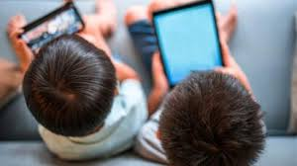


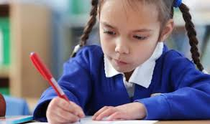
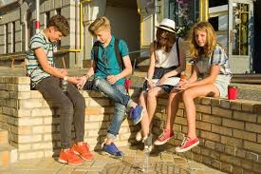
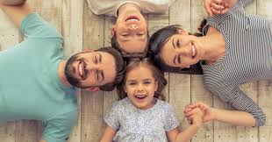
Where and how did you learn about sex and relationships?
For young people, their learning comes from…
TV
Internet
Mobile phones
School
Friends & Older Siblings
Parents & Carers

Slide 8
Why is relationships and sex education (RSE) important?
    Entitlement
    Puberty is starting earlier- for some children by age 8
    Unwanted conceptions
    Sexually transmitted infections
    Safeguarding
      Grooming
      Child Sexual Exploitation
      Abuse
      Sexting
      Online pornography

Slide 9
    Age appropriate
    Based on needs of pupil (see later slides)
    Progressive
    Inclusive
    Delivered by trained staff in a safe environment
    Prepares children adequately for puberty in a timely way
    Prepares children for adult life
    Promotes positive relationships
What is effective RSE?
Notes:
The focus in primary school and for our school should be on teaching the fundamental building blocks and characteristics of positive relationships, with particular reference to friendships, family relationships, and relationships with other children and adults (e.g. people who care for us).

Slide 10
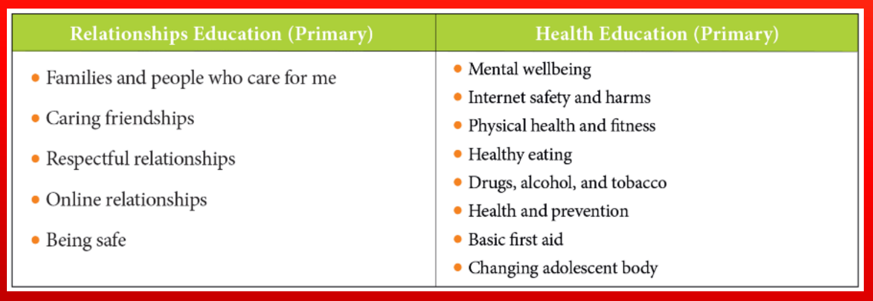
What does the new statutory guidance cover?

Slide 11
What does RSE look like across Year Groups?
Year 1 - Key learning outcomes
What is the same and different about us?
• children learn how they are similar or different to others, and what they have in common.
• children are also taught to use the correct names for the main parts of the body, including external genitalia; and that parts of bodies covered with underwear are private.
Who is special to us?
• children celebrate how different families may look and that families love and care for us.

Slide 12
What does RSE look like across Year Groups?
Year 2 - Key learning outcomes
What makes a good friend?
• how to ask for and give/not give permission regarding physical contact and how to respond if physical contact makes them uncomfortable or unsafe.
• use the correct names for the main parts of the body, and the similarities/differences between boys and girls (including external genitalia).
Notes:
These lessons consolidate what the children have already learnt in Year 1 and begin to develop children’s understanding that they own their own bodies. It also develops their awareness of who might need to see or touch their private parts (doctors, trusted grown-ups) and when this might need to happen. We will use a ‘distancing technique’ in which we are able to discuss sensitive scenarios through a made up character, without making the discussion personal.

Slide 13
What does RSE look like across Year Groups?
Year 3 - Key learning outcomes
How can we be a good friend?
Children can identify different types of relationships and build good friendships, including identifying qualities that contribute to positive friendships (including same sex relationships) .
What keeps us safe?
That their body belongs to them and should not be hurt or touched without their permission; what to do and who to tell if they feel uncomfortable.
Children talk about trusted adults and where to get help from if they feel worried about something, both on and offline.

Slide 14
What does RSE look like across Year Groups?
Year 4 - Key learning outcomes
How can we manage feelings?
How to feel good about myself and my body and to have an understanding of how the media presents body image.
How will we grow and change?
To understand that my body and emotions will change as I grow older and I know the importance of taking care of my own body.
Notes:
In these lessons, children learn about human development, exploring physical changes such as growing hair, changes to skin and general growth (linked with science). Emotionally, the children learn about hormones on a basic level and how through our teenage years we may experience different moods and emotions.

Slide 15
Right to withdraw
Parents have the right to request that their child be withdrawn from some or all of sex education delivered as part of statutory RSE. Parents should put a request in writing to the Head teacher. We will not be teaching Sex Education at Gosforth Park First School
You do not have the right to withdraw your children from any part of the relationships education curriculum
Good practice is also likely to include the head teacher discussing with parents the benefits of receiving this important education and any detrimental effects that withdrawal might have on the child. This could include any social and emotional effects of being excluded, as well as the likelihood of the child hearing their peers’ version of what was said in the classes, rather than what was directly said by the teacher.
Head teacher will grant a request to withdraw a pupil from any sex education delivered in primary schools, other than as part of the science curriculum.

Slide 16
Thank you!
As a school, we would always want to deliver a curriculum which has the support of the vast majority, if not all, parents.
We believe that children will accept information which is given to them in small chunks over time and at an age appropriate level more easily than information which is ‘kept secret’ until they are older.
We recognise that children need an increasing level of skill to deal with the modern world and the impact of social networking, advertising and media. Schools and parents have a responsibility to give a positive message which builds children’s resilience to the negative messages they may encounter through the easy availability of photo-shopped body images / TV programmes such as Love Island which portray sex as separate from relationships.
We would want all pupils to grow with the knowledge of natural changes before they happen, and pupils can encounter puberty at a relatively young age. For example, while the average age for a girl to begin menstruation in the UK is 12, many begin in Y6 and some in Y5. Less commonly, girls can begin their periods from 8 yrs old.
Notes:
Thank you for taking the time to read and listen to the PPT. If you have any questions please feel free to email the office and I will get back to you.

